Slide 1
Clock Driven Scheduling
Lecturer: BuiHa Duc, PhD
Department of Mechatronics

Slide 2
Assumptions
Clock-driven scheduling applicable to deterministic systems
  The parameters of all periodic tasks are known
  For each mode of operation, system has a fixed number periodic tasks
  Aperiodic jobs may exist
  There are no sporadic jobs

Slide 3

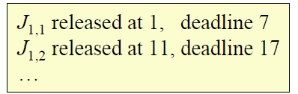

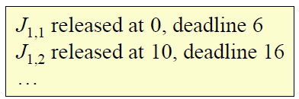
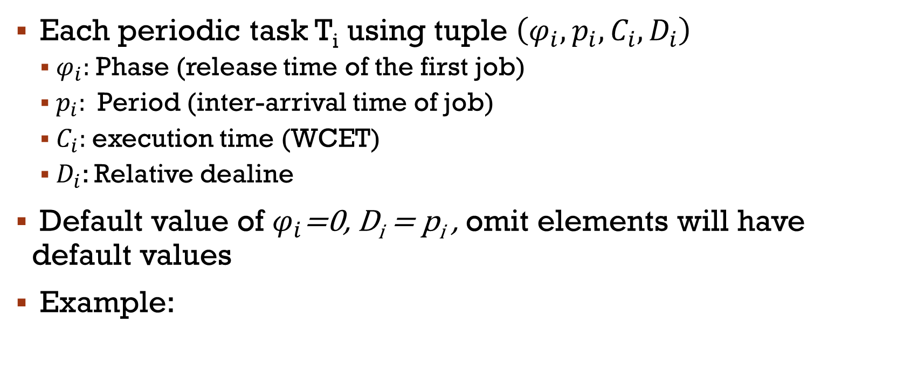
Notation
Each periodic task T_{i} using tuple $\left(φ_{i},p_{i},C_{i},D_{i}\right)$
  $φ_{i}:$ Phase (release time of the first job)
  $p_{i}$: Period (inter-arrival time of job)
  $C_{i}$: execution time (WCET)
  $D_{i}$: Relative dealine
Default value of $φ_{i}$=0, D_{i} = p_{i} , omit elements will have default values
Example:

Slide 4
Clock-driven scheduling
Implementing clock-driven scheduling in a real-time system involves a two-phase:
Off-line pre-computation
  Define the Task
  Generate a schedule that meets all the deadlines
Run-time execution
  Implement the schedule on cpu/system

Slide 5
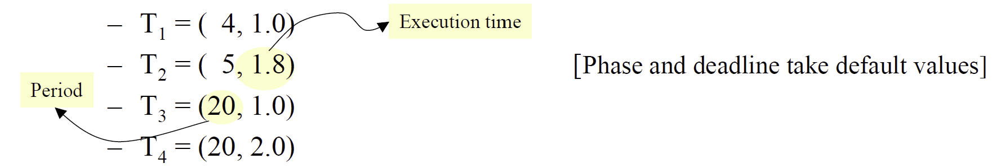
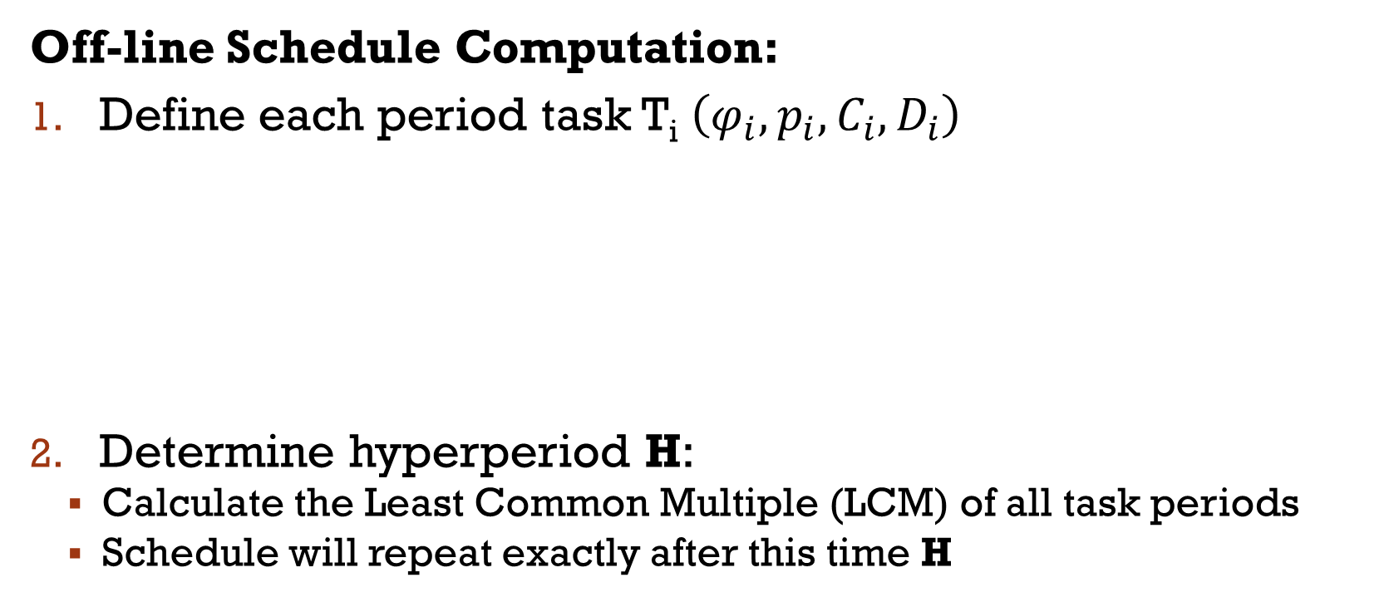
Clock-driven scheduling
Off-line Schedule Computation:
Define each period task T_{i} $\left(φ_{i},p_{i},C_{i},D_{i}\right)$
Determine hyperperiod H:
  Calculate the Least Common Multiple (LCM) of all task periods
  Schedule will repeat exactly after this time H

Slide 6
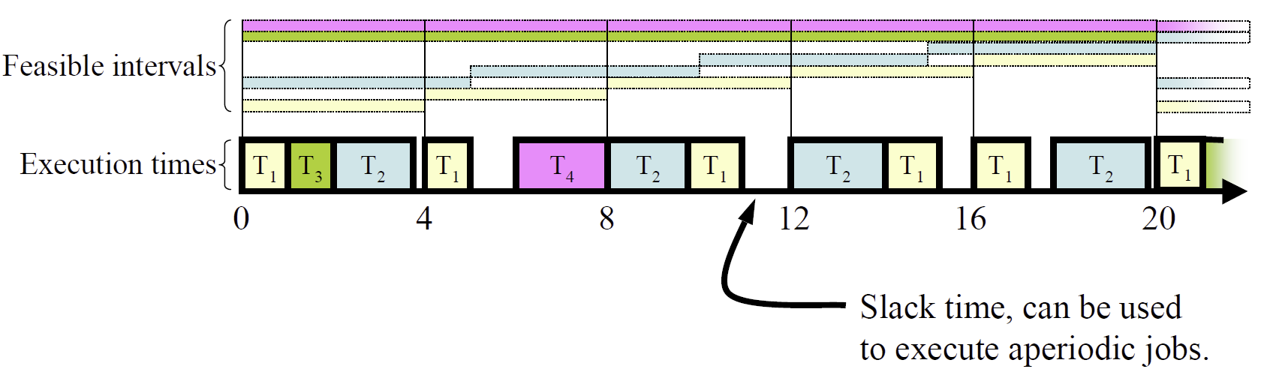
Example of cyclic schedule
Hyperperiod H = 20 (least common multiple of 4, 5, 20, 20)
An arbitrary static schedule to meet all deadlines:
Is this schedule optimized?

Slide 7
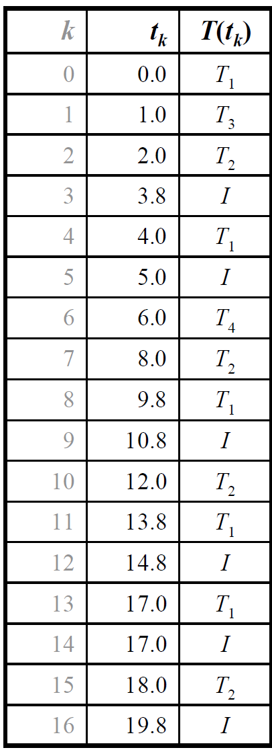
Example of cyclic schedule
Implement the schedule:
Scheduler sets the hardware timer to interrupt at the first decision time, t_{k}=0
On receipt of an interrupt at t_{k}:
  Scheduler sets the timer interrupt to expire at t_{k+1}
  If T(t_{k}) = I and aperiodic job waiting, start aperiodic job
  Otherwise, start next job in task T(t_{k}) executing
Is there any problem?

Slide 8
Example of cyclic schedule
Problems:
Relies on accurate timer interrupts and execution times of tasks
High scheduling overhead (amount of processor time or resources consumed)
  Reduce CPU availability
  Missed deadlines
  Increase jitter/unpredictability
Frames

Slide 9
Clock-driven scheduling
Off-line Schedule Computation:
Dividing the timeline into intervals called frames (F) of duration f
  f > max(C_{i}) : long enough to execute any job non-preemptively within a frame
  f is a divisor of H : to keep schedule table cyclic
  2f –gcd(p_{i}, f) ≤ D_{i} : short enough to ensure there is at least one frame boundary between a task's release time and its deadline, allowing the scheduler to check for and handle potential overruns
  gcd: Greatest Common Divisor
(Eq. 1)
without any interruptions
(Eq. 2)

Slide 10
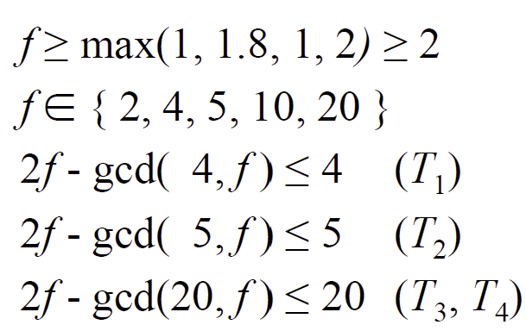
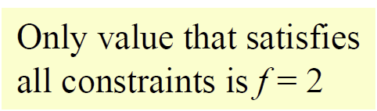
Example

Slide 11
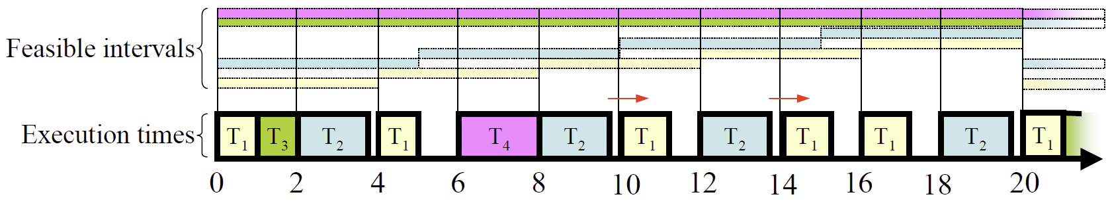
Example

Slide 12
Exercise
Generate the schedule table for the example problem

Slide 13
Clock-driven scheduling
Off-line Schedule Computation:
Job slicing: If the frame size constraints cannot be met, tasks must be broken down into smaller, non-preemptible slices
Example:
Consider a system with T₁ = (4, 1), T₂ = (5, 2, 7), T₃ = (20, 5)
Eq. 1→ f ≥ 5, but Eq. 2 → f ≤ 4
Solve by splitting T₃ into T_{3,1} = (20, 1), T_{3,2} = (20, 3) and T_{3,3} = (20,1)
Result can be scheduled with f = 4

Slide 14
Clock-driven scheduling
Off-line Schedule Computation:
Construct the static schedule
  task (or slice) is to be executed at the beginning of each frame
  guarantee that all hard real-time deadlines are met
  table will store entries (t_{k}, T(t_{k})), where t_{k} is the decision time (start of the frame) and T(t_{k}) is the task/slice to execute.

Slide 15
Clock-driven scheduling
Run-time Execution
Initialization: The scheduler sets up the system, creates all tasks, and sets a hardware timer to interrupt at the beginning of the first frame (t₀)
Timer Interrupt: When the timer interrupts (at t_{k}, the start of a frame)
  The scheduler preempts any lower-priority task currently running (like an aperiodic job).
  It checks the static schedule table for the task/slice T(t_{k}) assigned to the current frame.
  It sets the timer to expire at the beginning of the next frame (t_{k+1}). It then dispatches the job T(t_{k}) to execute.

Slide 16
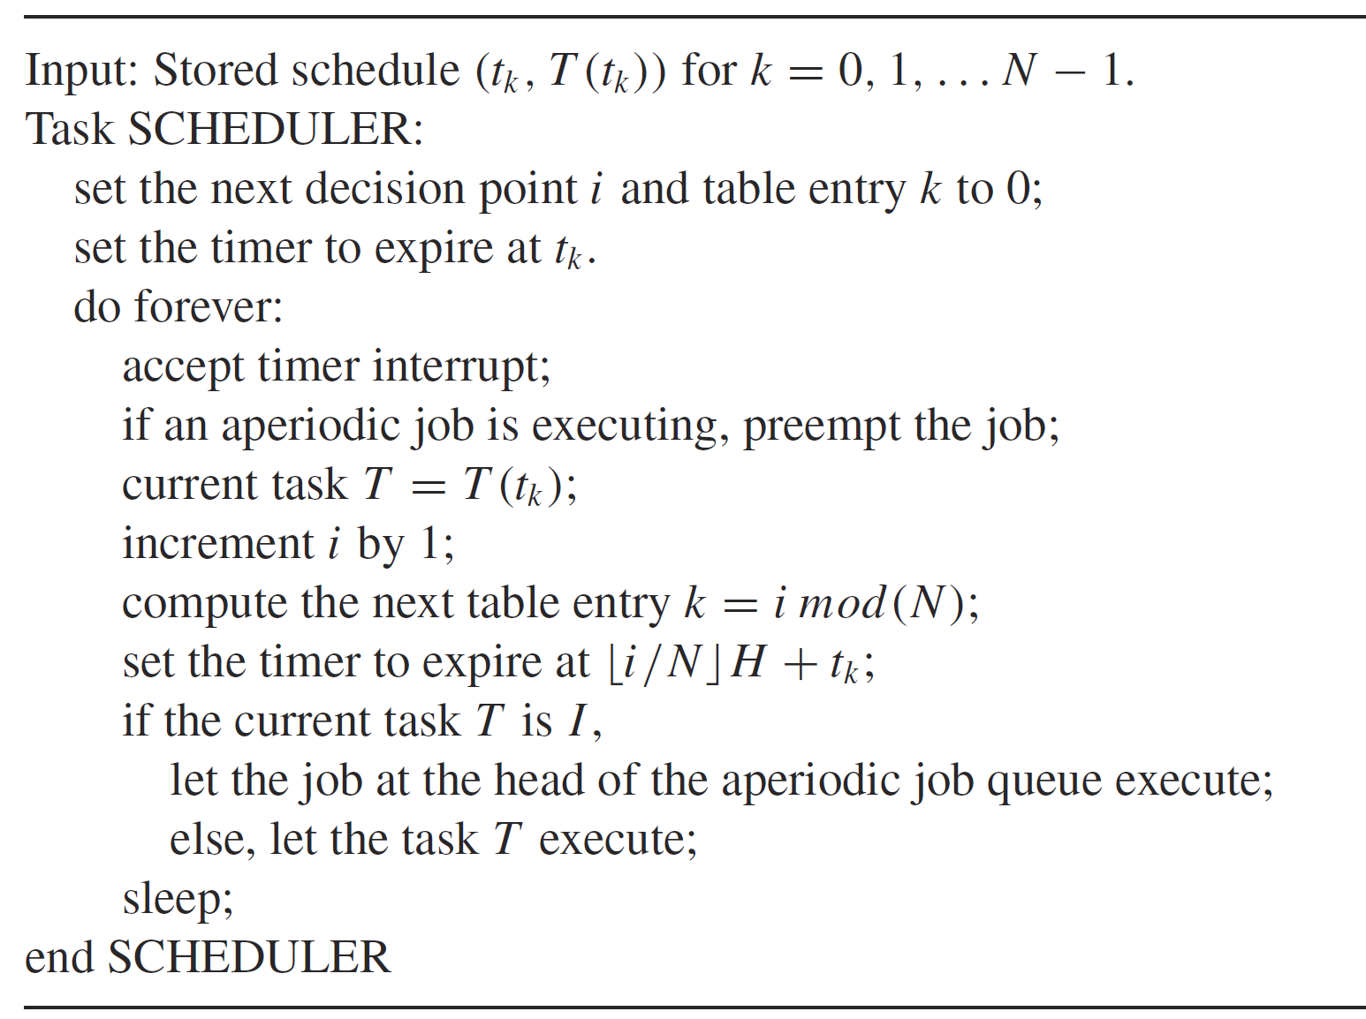
Clock-driven scheduling

Slide 17
Clock-driven scheduling
Handling Aperiodic/Sporadic Jobs
Idle Time Execution: Aperiodic jobs are often
  Execute Aperiodic jobs during any idle time within a frame,
  Using a First-Come, First-Served (FCFS) approach
Slack Stealing:
  Compute the maximum available time (slack) that can be "stolen"
  Move the slack time to the start of the frame
  Running the periodic jobs just in time to meet their deadline

Slide 18
Practical Considerations
Handling overruns:
  Killing the job and starting an error recovery task
  Preempting the job and scheduling the remainder as an aperiodic job
Mode changes:
  Generate different schedule tables for different modes
Multiple processors:
  Possible but off-line scheduling table generation more complex

Slide 19
Clock-driven Scheduling: Advantages
Conceptual simplicity
  Entire schedule is captured in a static table
  Different operating modes can be represented by different tables
  No concurrency control or synchronization required
Timing constraints can be checked and enforced at each frame boundary
Choice of frame size can minimize context switching and communication overheads
Relatively easy to validate, test and certify

Slide 20
Clock-driven Scheduling: Disadvantages
Inflexible
  If anything changes, have to redo the table generation
  Best suited for systems which are rarely modified once built
Release times of all jobs must be fixed
All possible combinations of periodic tasks that can execute at the same time must be known, so that the combined schedule can be precomputed
The treatment of aperiodic jobs is very primitive

